Slide 1
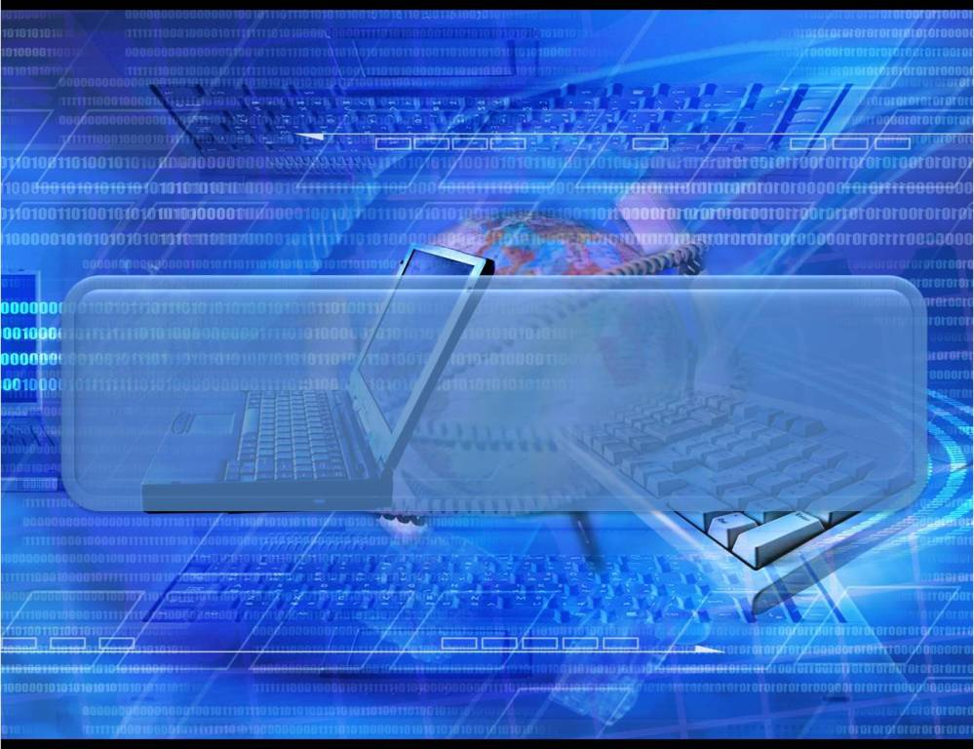
Predictions for the future
7th Spotlight
Module 5

Slide 2

Before reading … … p. 46
be very different очень разные
be so polluted такая загрязненная
be able to быть способным
exist существовать
mini-submarines мини подводные лодки
moon shuttle лунный челнок
have enough money … достаточно …
believe верить
traffic jam дорожная пробка
fuel топливо
cause pollution быть причиной
загрязнения

Slide 3
Check your vocabulary, will you?
different life другая жизнь
drive flying cars водить летающие машины
not exist any more больше не существует
live in glass domes жить в стеклянных куполах
live in underwater city жить в городе под водой
travel by moon shuttle путешеств. в челноке на луну
travel in submarines путешеств. в подводных лодках
have enough money … достаточно …
robotic housemaid робот в домаш. хозяйстве
traffic jams дорожные пробки
use another fuel использовать др. топливо
so polluted Earth такая загрязненная Земля
cause pollution быть причиной загрязнения

Slide 4
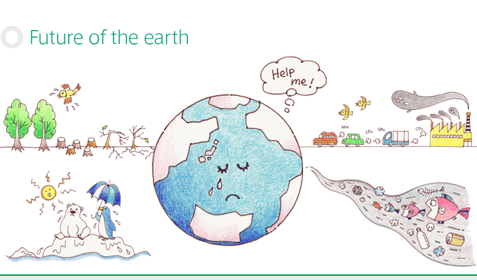
№ 1 Future life will be
easier
more interesting
more difficult
Notes:
Задания по тексту - на понимание главной идеи. Иллюстрации в помощь.

Slide 5
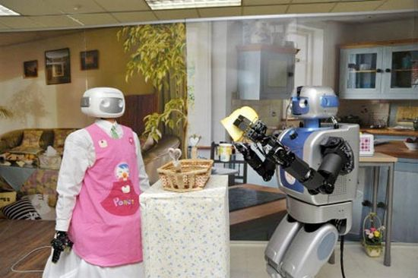
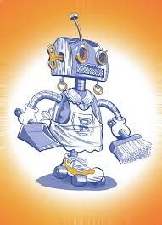
№ 2 Robotic housemaids will help people …
            take dogs for a walk
            clean the house,
            wash the dishes
            feed the pets,
            look after kids.
Notes:
Задания по тексту - на понимание главной идеи.

Slide 6
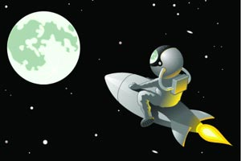
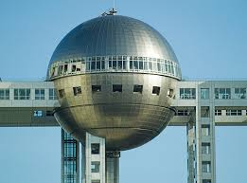
№ 3 People will go on holiday
around the Earth
to the moon
to other planets
Notes:
Задания по тексту - на понимание главной идеи.

Slide 7
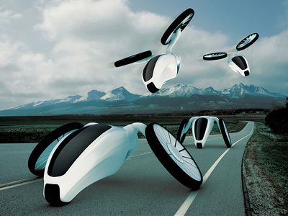
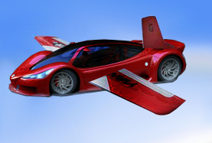
№ 4 Future cars will not use
fuel and that’s why life will be
more dangerous
safer and better
worse but safer
better and more exciting
Notes:
Задания по тексту - на понимание главной идеи.

Slide 8
Check yourself, will you?
Will people live in underwater cities in the future?
Robotic housemaids will help us with the cleaning …
Ben thinks that life will be different in the future.
I don’t think the world won’t / will change that in the future.
When they come back, we’ll go to the cinema.
When / will computers talk in 100 years’ time?
Jen has to look after her younger sister this weekend.
Will you look up this person in the … book, please?
Why don’t we look for a cheap … holiday on the Net?
I look forward to going Spain!
Assess yourself, please.
10-9 points = Excellent = “5”
8-7 points = Good = “4”
6-5 points = Satisfied = “3”
< 5 = Unsatisfied = Learn more!!!

Slide 9
Future forms // Ways … about future
Future Tenses | Other Ways
Future Simple will/shall + V спонтанное решение (on-spot-decision) обещания (promise), угрозы … предсказания (predictions), основанные на … we think / believe | be going to V планы, намерения, амбиции (собираться что-то сделать) предсказания (predictions), основанные на … we see / know
Future Continuous will be Ving Д. будет происходить (в процессе) at /в определенное время в будущем This time tomorrow/ next week …. | am/is/are Ving запланированное действие в будущем
Future Perfect will have been V_{ed}/₃ Д. произойдёт by / к определенному мнению в будущем | V/Vs будущее Д. по расписанию в придаточных времени и условия вместо Future I’ll do it if I have time I’ll do it when I have time
Future Perfect Continuous will have been Ving подчёркиваем длительность буд. Д.

Slide 10
Check yourself, will you?
With the money I have, I ______ a computer.
A) will buy B) buy
2. If you finish work early, _____ call me?
A) do you call B) will you call
3. When the weather _____ cold, he’ll go out.
A) is B) will be
4. If I study hard, I _____ fail the exam tomorrow.
A) will B) won’t
5. I don’t think he ______ if I invite him.
A) comes B) will come

Slide 11
Match the words, will you?
digital
e-book
robotic
underwater
flying
glass
mobile
virtual
A) devices
B) housemaids
C) cars
D) cities
E) phones
F) domes
G) cameras
H) pet

Slide 12
Check yourself, will you?
digital cameras
e-book devices
robotic housemaids
underwater cities
flying cars
glass domes
mobile phones
virtual pets
Assess yourself, please.
8 points
= Excellent = “5”
7 points
= Good = “4”
6-5 points
= Satisfied = “3”
< 5 = Unsatisfied
= Learn more!!!

Slide 13
Check your homework, will you?
Arguments in favour of
virtual / computerised pets | real pets
☺ don’t have to clean up after them | … … can show ☺ affection
… … don’t need a vet | … … can protect ☺ in trouble
… … don’t bark when hungry. Owners can feed …. easily by pressing buttons on the gadget | … … are expensive to keep because ☺ have to buy food and other necessary things
… … don’t shed hair | it’s a perfect way to have a rest and forget about problems by playing with them
It is great if ☺ are in allergic to animals | Having real … helps ☺ to learn how to take care of other creatures

Slide 14
Let’s practice listening, shall we?
Ex. 8 p. 49
headphones
speaker
2,000
& 199
0800 755 844
Assess yourself, will you?

Slide 15
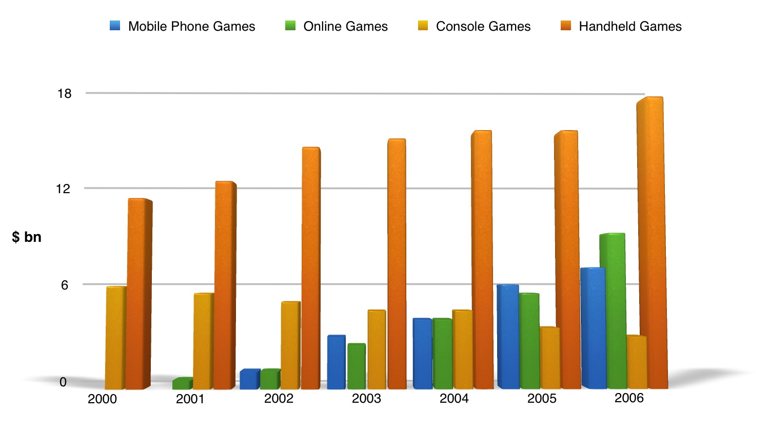
According to this bar graph,
we can say that … …
____ is/are more and more popular every year.
____ are more / less popular that ____

Slide 16
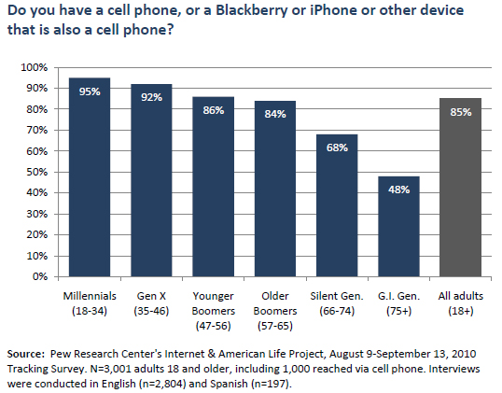
According to this bar graph,
we can say that … …

Slide 17
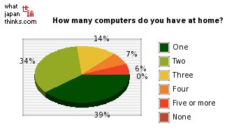
According to this pie chart/graph,
we can say that … …
Most ☺ (___per cent) have … … … .
… only ____ per cent of ☺ have … … … .

Slide 18
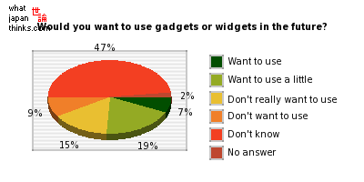
According to this bar graph,
we can say that … …

Slide 19
My predictions
for the future

Slide 20
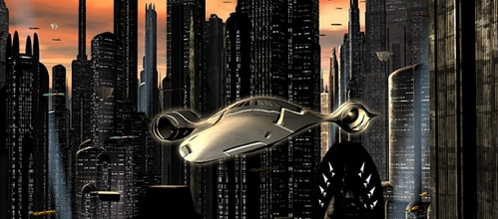
People will have
flying strange cars and
they will be able to fly around the towns

Slide 21
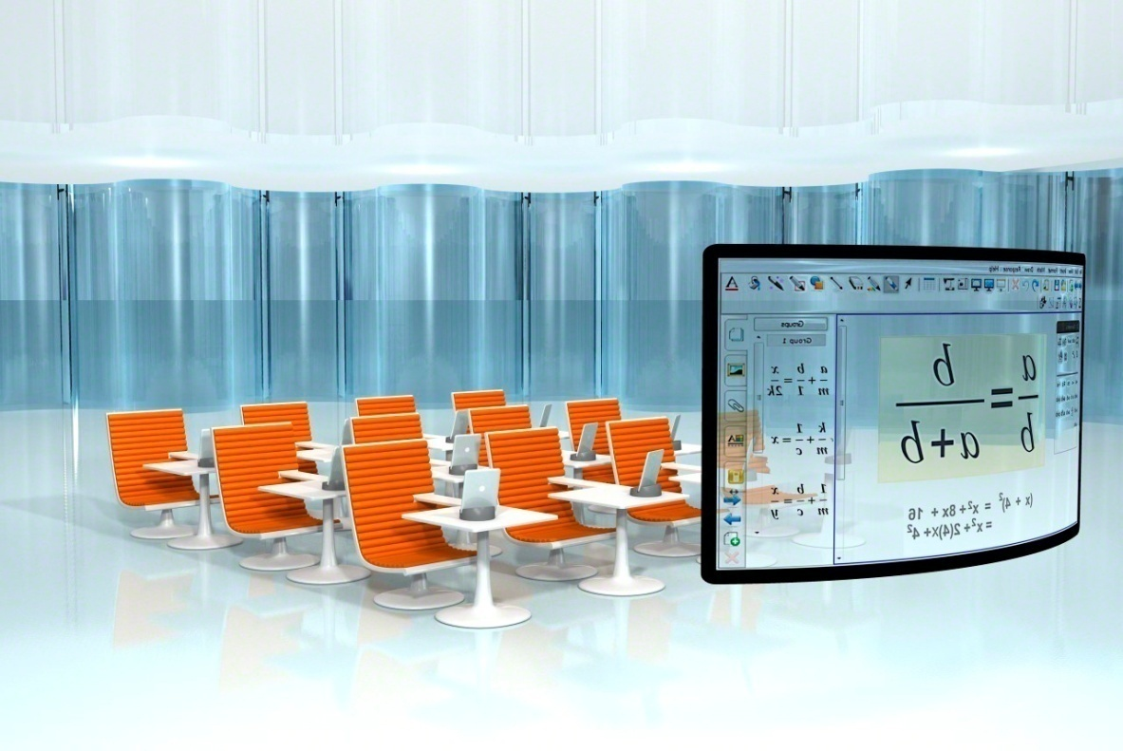
Schools in future will change.
Classrooms with desks and blackboards will be different BUT nothing won’t replace teachers

Slide 22
Ссылка на он-лайн тест goo.gl/Xxd5c8
Подготовила
Скорнякова Ольга Владимировна
Г. Радужный ХМАО-Югра
МБОУ СОШ № 6
Уважаемые коллеги!
Я буду рада, если данная презентация сэкономит чье-то время и энергию. Только, пожалуйста, не выставляйте данную презентацию под свои именем на других сайтах.
Были уже такие случаи.
Извините, если что….. Заранее спасибо за понимание!

